Slide 1
Data Mining: Linear Algebra (Recap)
Tom Heskes

Slide 2
Linear Algebra
vectors and matrices
operations on these
SVD and PCA
Note: see Appendix A and B of TSK

Slide 3
Vectors
A vector has a length and a direction
Interpretation: a line in N dimensional space
For example, 2 steps in x-direction and 1 step in y-direction
y
v
x

Slide 4
Vectors: Addition
Head-to-tail method
Note: interpretation always relative to “tail”
u
u+v
v
v
u

Slide 5
Properties of Vector Addition
Commutativity: u + v = v + u
Associativity: (u + v) + w = u + (v + w)
Identity element: u + 0 = u
Additive inverse: u + (-u) = 0

Slide 6
Vectors: Scalar Multiplication
same direction
only changes length
3 u
u

Slide 7
Multiplying a Vector by a Scalar
Associativity: a (b u) = (a b) u
Distributivity (I): (a + b) u = a u + b u
Distributivity (II): a (u + v) = a u + a v
Scalar identity: 1 u = u

Slide 8
Vector Space
Set of vectors with associated set of scalars (real numbers)
Closed under addition and scalar multiplication
Any vector can be represented as a linear combination of a basis {u₁,…, u_{n}}, i.e., we can always find {a₁,…,a_{n}} such that

Slide 9
Basis Vectors
Basis vectors “span” the vector space
Dimension of vector space: minimum number of basis vectors needed
Typically unit length and orthogonal (more later)
For example, in two-dimensional Euclidean space:

Slide 10
Dot Product
Dot product or scalar product or inner product:

Slide 11
Orthogonal Vectors
Two vectors u and v are said to be orthogonal if
For example,
Euclidean space: orthogonal = perpendicular

Slide 12
Length and Angles
Length of a vector:
Generalization of Pythogoras:
Dot product in terms of angles:
u
u₂
u₁

Slide 13
Projection
Projection of v on u:
Example:
v
θ
v_{u}
u

Slide 14
Linear (In)dependence
A set of vectors is linearly {independent / dependent} if {no / at least one} vector in the set can be written as a linear combination of the other vectors in the set.
independent
dependent
independent
dependent

Slide 15
Vectors and Data analysis
Often used in computing similarities and distances between objects
For example, cosine similarity
Euclidean distance

Slide 16
Matrices
A matrix is a set of elements, organized into rows and columns
“n by m” matrix: n rows and m columns
rows
columns

Slide 17
Matrix as a Set of Vectors
First subscript indexes rows
Second subscript indexes columns
Column of row vectors or row of column vectors

Slide 18
The Transpose of a Matrix
Note that (X^{T})^{T} = X

Slide 19
Properties of Matrix Addition
Commutative: A + B = B + A
Associative: A + (B + C) = (A + B) + C
Identity: A + 0 = A
Additive inverse: A + (-A) = 0

Slide 20
Multiplying a Matrix by a Scalar
Associativity: b (c A) = (b c) A
Distributivity (I): (b + c) A = b A + c A
Distributivity (II): c (A + B) = c A + c B
Scalar identity: 1 A = A

Slide 21
Matrix Multiplication
If then
For example,

Slide 22
Multiplying a Matrix by a Matrix
Associativity: A (B C) = (A B) C
Distributivity: (B + C) A = B A + C A and A (B + C) = A B + A C
Identity matrix: I A = A = A I
No commutativity: A B ≠ B A

Slide 23
Vector Interpretation
Think of a matrix as a transformation on a line or set of lines
u
u’

Slide 24
Scaling Matrix
Same direction, only changing length:
Easy to check: C u = c u for any u

Slide 25
Rotation Matrix
Rotate, leave length intact
Two-dimensional rotation around angle θ
For example, θ = 90º:
u
u’

Slide 26
Reflection Matrix
Reflect along one of the coordinate axes
Example:
u’
u

Slide 27
Projection Matrix
Project onto lower-dimensional subspace
General case, projection onto vector u:
see
u’
u

Slide 28
Linear transformations
Matrices are linear transformations: A (u + v) = A u + A v
Column space: the set of all column vectors. Any result can be written as the linear combination of those vectors:
Similarly, row space, set of all row vectors:

Slide 29
Rank of a Matrix
Dim of {column/row} space {d_{col} /d_{row}}: number of linearly independent {columns/rows} of A
It can be shown that d_{col} = d_{row}, which is called the rank of the matrix
2
2
1
1

Slide 30
Matrix Inverse
Only for square matrices with rank equal to the number of rows (and thus columns)
Rotation matrices are invertible, projection matrices not
The inverse of a matrix is such that: AA⁻¹ = I = A⁻¹A with I the identity matrix
Inversion is a bit tricky: (AB)⁻¹ = B⁻¹A⁻¹

Slide 31
Examples
Diagonal matrix (but only then...)
Rotation matrix
since

Slide 32
Eigenvalues and Eigenvectors
u is an eigenvector of matrix A with corresponding eigenvalue λ if A u = λ u
u should be such that its direction does not change, only the length
Example, the matrix has 2 eigenvalue/vector combi’s: and

Slide 33
Eigenvalue Decomposition (1)
If A is an n by n matrix with n independent (orthogonal) eigenvectors u₁ through u_{n} and corresponding nonnegative eigenvalues λ₁ through λ_{n}, then it can be decomposed as with and Λ a diagonal matrix with elements λ₁ through λ_{n}

Slide 34
Eigenvalue Decomposition (2)
Check:
Example:
eigenvectors
eigenvalues

Slide 35
Singular Value Decomposition
Generalization of eigenvalue decomposition to non-square matrices
A is m by n, can be expressed as
U is m by m, V is n by n, Σ is a diagonal matrix with non-negative entries; U and V are orthonormal, i.e., U U^{T} = I and V V^{T} = I
Relation to eigenvalue decomposition: u_{i}’s (left singular vectors) are eigenvectors of AA^{T}, v_{i}’s (right singular vectors) of A^{T}A
Dimensionality reduction: set small singular values to zero

Slide 36


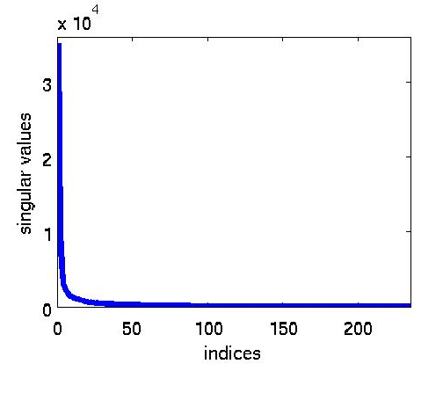
SVD for Dimensionality Reduction
Treat picture as a matrix A of gray values
Apply SVD: A = U Σ V^{T}
Keep only 20 singular values: set σ_{i} = 0 for i > 20
Transform back to A = U Σ V^{T}
original
compressed

Slide 37
Dimensionality Reduction
Purpose:
Avoid curse of dimensionality
Reduce amount of time and memory required by data mining algorithms
Allow data to be more easily visualized
May help to eliminate irrelevant features or reduce noise
Techniques
Principal Component Analysis/Singular Value Decomposition
Others: supervised and non-linear techniques

Slide 38
Principal Component Analysis
The direction with the largest variation makes the first principal component
The direction orthogonal to the principal direction with then the largest variation makes the second principal component, and so on
These happen to correspond to eigenvectors of the covariance matrix, ordered by their corresponding eigenvalues
Equivalent: singular value decomposition on mean-centered data

Slide 39
Basic Statistics
Given a data matrix X with n objects in m dims
Mean
Variance
Covariance
Covariance matrix Σ with σ_{jk} = Cov(x_{j},x_{k})

Slide 40
Plot
Data appears to be correlated

Slide 41
Compute the Covariance Matrix
Move to a mean-centered coordinate system
Calculate the covariance matrix:
Diagonal terms are the variances in the two directions
Off-diagonal terms are the covariances /cross-correlations

Slide 42
Rotate to Remove the Correlations
Now rotate to decorrelate
Covariance matrix in the coordinate system
σ₂
σ₁

Slide 43

Dimensionality Reduction: PCA (1)
Goal is to find a projection that captures the largest amount of variation in data
Find the eigenvectors of the covariance matrix
The eigenvectors define the new space
Example: largest variation in the direction of e₁, the first principal component
Next principal component e₂ perpendicular to e₁
x₂
e₂
e₁
x₁

Slide 44
Dimensionality Reduction: PCA (2)
x₂
Project the data points onto the first few principal components
Example: project onto e₁, i.e., ignore variations in the direction of e₂
In math, projection matrix:
Contribution in direction of e₁:
Reconstruction:
e₁
x₁

Slide 45
Eigenfaces (1)
Eigenfaces are the eigenvectors of the covariance matrix of the statistical distribution of the vector space of human faces
Eigenfaces are the ‘standardized face ingredients’ derived from the statistical analysis of many pictures of human faces
A human face may be considered to be a combination of these standard faces

Slide 46
Eigenfaces (2)
To generate a set of eigenfaces:
Large set of digitized images of human faces is taken under the same lighting conditions
The images are normalized to line up the eyes and mouths
The eigenvectors of the covariance matrix of the statistical distribution of face image vectors are then extracted
These eigenvectors are called eigenfaces

Slide 47
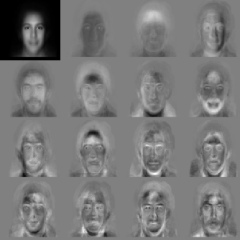
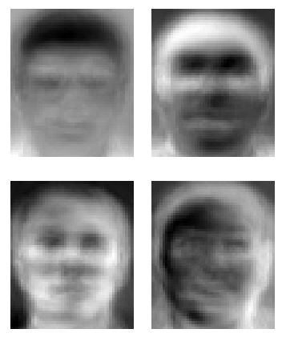
Eigenfaces (3)
http://en.wikipedia.org/wiki/Eigenface

Slide 48
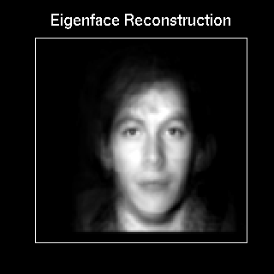
Eigenfaces (4)
When properly weighted, eigenfaces can be summed together to create an approximate gray-scale rendering of a human face
Remarkably few eigenvector terms are needed to give a fair likeness of most people's faces
Hence eigenfaces provide a means of applying data compression to faces for identification purposes

Slide 49
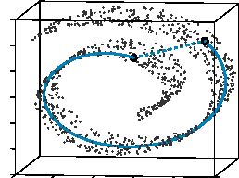
Dimensionality Reduction: ISOMAP
Construct a neighbourhood graph
For each pair of points in the graph, compute the shortest path distances – geodesic distances
Also works for non-linear manifolds
Tenenbaum, de Silva,, Langford (2000)

Slide 50
GANs for Face (Style) Interpolation
Nvidia, 2018

